Slide 1
Binding Business Services with the User Interface

Slide 2
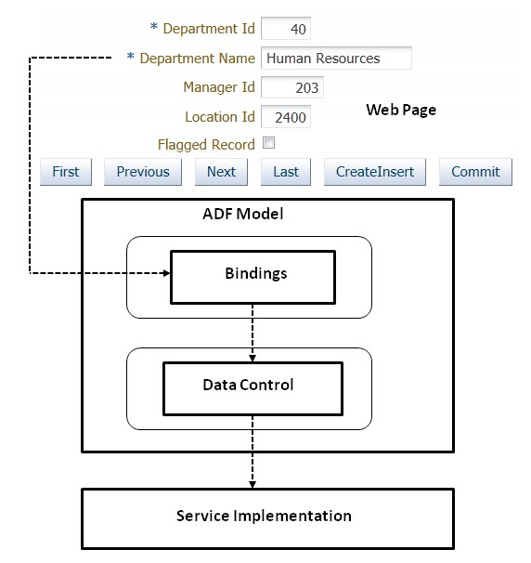
Binding model data with user interfaces

Slide 3
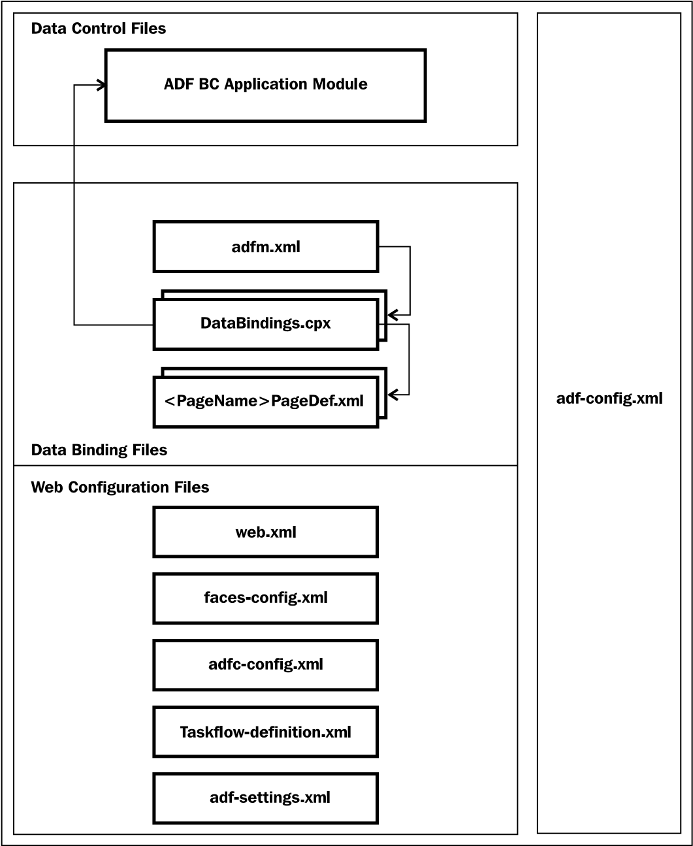
ADF Model metadata files

Slide 4
ADF Model metadata files
adfm.xml : Is a registry of registries used by the framework to quickly find all metadata registry files used at runtime:
Data binding registry (DataBindings.cpx)
Data control registry (DataControls.dcx)
Business component service registry (bc4j.xcfg)
Business component project registry (<ModelProject>.jpx)

Slide 5
DataBindings.cpx , adf-settings.xml
The DataBindings.cpx file defines the runtime binding context for the entire application. This file contains mapping between page and page definition files, and metadata definition for the data control usage
ADF Settings is designed to store project-level or library-level settings for view layers such as ADF Faces help providers, phase listeners, MDS web-app prefix, and web cache configuration information. You cannot alter the configuration settings for this file during or after application deployment. This file is located in the <application>\<ViewController>\src\META-INF directory.

Slide 6
adf-config.xml
adf-config.xml : The adf-config.xml file provides a central metadata file to manage application-wide configuration data. This file is located in <Application>/. adf/META-INF/adf-config.xml and there should be only one such file in the application.
The application's adf-config.xml contains the following configuration entries:
MDS configuration
ResourceBundle override information
Security context
Application UID
The oracle.adf.share.ADFConfig class represents the runtime representation of the adf-config.xml file. ADFConfig is a customizable document and it uses the metadata service (MDS) to persist customizations. Updates to ADFConfig are checked and updated, if needed, at the start of each HTTP request.

Slide 7
Programmatically accessing page binding elements
Accessing binding container :
public BindingContainer getBindingContainer() {
BindingContext bindingContext = BindingContext.getCurrent();
return bindingContext.getCurrentBindingsEntry();
}

Slide 8
Programmatically accessing the parameter binding
Accessing binding container :
<parameter id="DeptIdParam" value= "${viewScope.deptId != null ? viewScope.deptId : 10 }" evaluate="inPrepareModel"/>
BindingContainer bc = getBindingContainer();
Map map= bc.getParametersMap();
Long deptIdParam=(Long)((DCParameter)map.get("DeptIdParam")).getValue();

Slide 9
Programmatically executing method action binding
BindingContainer bc = getBindingContainer();
OperationBinding opb = bc.getOperationBinding("updateDepartmentDeatils");
opb.getParamsMap().put("departmentRow", currentDeptRow);
Object returnValue = opb.execute();
if (opb.getErrors().isEmpty()) {
} else {
List errorList = opb.getErrors();
}

Slide 10
Accessing the list control binding
<list IterBinding="EmployeesIterator" StaticList="false"
Uses="LOV_DepartmentId" id="DepartmentId"
DTSupportsMRU="false" SelectItemValueMode="ListObject"/>
JUCtrlListBinding lb = (JUCtrlListBinding)bc. getControlBinding("DepartmentId");
Row selectedRow = (Row)lb.getSelectedValue();
Integer deptId= (Integer)selectedRow. getAttribute("DepartmentId");

Slide 11
Accessing the attribute binding
<attributeValues IterBinding="DepartmentsIterator"
id=" DepartmentId">
<AttrNames>
<Item Value="DepartmentId"/>
</AttrNames>
</attributeValues>
AttributeBinding departmentIdBinding = (AttributeBinding)bc.getControlBinding("DepartmentId") ;
Integer deptId=(Integer)departmentIdBinding.getInputValue();

Slide 12
Accessing the iterator binding and associated view object
<iterator Binds="Departments" RangeSize="25" DataControl="HRServiceAppModuleDataControl“ id="DepartmentsIterator" ChangeEventPolicy="ppr"/>
DCBindingContainer bc = (DCBindingContainer) getBindingContainer();
DCIteratorBinding iteratorBinding = bc. findIteratorBinding("DepartmentsIterator");
iteratorBinding.executeQuery();
//ViewObject vo = iteratorBinding.getViewObject();

Slide 13
What happens when you access a Fusion web page?
When a client (for example, a web browser) requests a page, the web server inspects the application name present in the URL and delegates the request to the appropriate web application deployed on the server. Once the request is routed to the target application that application takes over the request processing job. A Fusion web application uses the Faces Servlet (javax.faces.webapp.FacesServlet) to control the processing of a request.
The ADF Faces framework is extended from JSF with extra features such as declarative data bindings and an enhanced security model that calls for pre-processing using filters.
JPS filter : This filter is used to set up the Oracle Platform Security Services (OPSS) policy provider.
Trinidad filter: This ensures that Trinidad is properly initialized by establishing a RequestContext object.
ADF Binding filter : This is used to pre-process any HTTP requests that may require access to the binding context

Slide 14
What happens when you access a Fusion web page?
When the request reaches ADFBindingFilter, it looks for the ADF binding context in the HTTP session, and if it is not yet present, initializes it for the first time. The ADF binding context contains data binding metadata, such as page definition usages and data control usages for the application. ADFBindingFilter performs the following tasks on a high level:
Finds the name of the binding context metadata file( the .cpx extension file ), reads the entries, and generates binding context
Creates SessionContext, if it's not existing
Sets up the error handler
Sets up locale
Creates the binding container for the page
Finds or constructs an instance of each data control present in the binding container for the requested page

Slide 15
What happens when you access a Fusion web page?
Faces Servlet by design follows an extensible architecture. It allows you to configure a custom lifecycle implementation for the JSF pages by overriding the default lifecycle-factory entry in the faces-config.xml file , Customized javax.faces.lifecycle.LifecycleFactory can be coded to return custom lifecycle implementation.

Slide 16
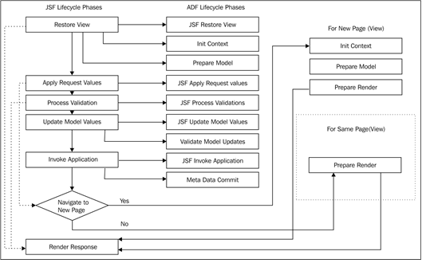
ADF Lifecycle Phases

Slide 17
What happens when you access a Fusion web page?
Restore view: The component tree for the view of the requested page is either newly built or restored. The framework attempts to restore the component tree if the view has been already processed and the component tree is available in the FacesContext object.
JSF restore view: This phase is extended from the restore view phase in the JSF lifecycle. Custom phase listeners can listen on the before and after events of this phase, to perform extra processing, if any. As mentioned earlier, the framework deploys a set of internal ADF page I ifecycle listeners to carry out extra tasks during the page lifecycle. During the before phase event for the JSF restore view, UpdateBindingListener (an internal ADF page lifecycle listener) initializes the binding container object by calling findBindingContainerByPath() on the BindingContext object, which finds the page definition file that matches the URL and builds the binding container for the page. The ADF Controller uses listeners for the before and after events of this phase to synchronize the server-side state with the request. The page flow scope is available at the end of this phase.

Slide 18
What happens when you access a Fusion web page?
Prepare model: During the Prepare model phase, the framework does the following:
Page parameters defined in the page definition are evaluated.
If a task flow binding with parameters exists in the page definition, parameters are evaluated and are passed into the task flow.
For any executables entry, whose refresh property is set to prepareModel, is executed. This leads to execution of the underlying datasource available on the data control. This explains how the page binding reads the data from the datasource when a page loads.
If the page has been created by using a template that uses ADF binding, the binding container for the page template is initialized during this phase.
The task flow executable binding is executed during this phase.
If this is the initial request for the page, the lifecycle skips the process validations, update model values, and invoke application phases and jumps to the render response phase. The next phase continues for postback requests.

Slide 19
What happens when you access a Fusion web page?
Update model values: During this phase, the component's validated local values are moved to corresponding server-side properties. If the value of an updatable component is bound to a managed bean property, the local value is copied to the corresponding managed bean property. If the value of an updatable component is bound to the attribute in an iterator, the corresponding iterator is refreshed first (if the refresh is deferred and refreshCondition is evaluated to true), and then the local value of the component is copied to the corresponding attribute. This will call setter on the corresponding attribute in the view row implementation class, which in turn calls setter on underlying entity implementation (if exists).
Before updating the actual data storage (for example, the entity object), the framework will process all the validations defined on the attribute and on successful validation, the value is copied to the underlying data storage and the control proceeds to the next phase. If the validation fails, the lifecycle jumps to the render response phase. Exceptions are caught by the binding container and cached for display during the render response phase.

Slide 20
What happens when you access a Fusion web page?
Validate model updates: The validation defined on the underlying entity object (validation added through the entity validators) is processed during this phase. Exceptions are caught by the binding container and cached for displaying during the render response phase.
Invoke application: During this phase, application events are invoked. For example, if you have specified any action event for a command button, it is processed in this phase. If navigation is specified for the action, navigation to a different view happens at the end of this phase.
Metadata commit: This is executed after the invoke application phase. During this phase, changes to runtime metadata are committed to the data store, which is configured using MDS.
Prepare render: During this phase, the binding container is refreshed to reflect the changes performed in the previous phases. Iterators whose refresh property is set to renderModel, are refreshed during this phase.

Slide 21
What happens when you access a Fusion web page?
Render response: The page is built during this phase. If this is the initial request for the page, the component tree for the page is built during this phase and appended to UIViewRoot. Once the tree is built, each component is asked to write its value into the response object and the state of the response is saved either on the client or server, based on the configuration.
ADF Faces has data streaming support for certain components such as tables, trees, tree tables, and data visualization components, where the data fetch for these components happens in another request, after rendering the page. The framework executes only the render response phase for data streaming requests.

Slide 22
Invoking an application module from a Java servlet
There are two approaches:
Using Configuration::createRootApplicationModule(String qualifiedAMDefName, String configName) to create an appropriate application module instance, and then calling desired methods on it
Using ADF Model APIs for accessing business methods exposed through data control

Slide 23
Using createRootApplicationModule() in HttpServlet
Configure oracle.adf.share.http.ServletADFFilter in the web.xml file to ensure the proper initialization of oracle.adf.share.ADFContext while accessing the application module from a non-ADF web application, using the servlet
String amDef = "com.fanousoft.model.service.HRServiceAppModule";
String config = "HRServiceAppModuleLocal";
am = (HRServiceAppModuleImpl) Configuration.createRootApplicationModule(amDef, config);
am.runSalaryRevisionReoutine();
}catch(Excpetion ex){
}finally{
if(am !=n ull){
Configuration.releaseRootApplicationModule(am, false);
} }

Slide 24
Using ADF binding APIs in an HttpServlet
The ADF binding layer makes use of metadata XML files for holding binding information. To use a binding API from a non-ADF web application, you may need to manually create the adfm.xml, DataBindigs.cpx, and pageDef.xml files in the respective folders and then use ADF binding APIs from a servlet (or any other Java class) for accessing a data collection exposed through data control.

Slide 25
doGet in HttpServlet
DCBindingContainer dcBindingContainer =
BindingContext.getCurrent().findBindingContainer("view_warehousesPageDef");
JUCtrlRangeBinding depts = (JUCtrlRangeBinding)dcBindingContainer.findCtrlBinding("WarehousesView1");
dcBindingContainer.refreshControl();
List<JUCtrlValueBindingRef> deptsList = depts.getRangeSet();
Iterator deptsIter = deptsList.iterator();
while (deptsIter.hasNext()) {
JUCtrlValueBindingRef valueBinding = (JUCtrlValueBindingRef)deptsIter.next();
Row attrs = valueBinding.getRow();
out.println(attrs.getAttribute("WarehouseName") + "<br/>");
}
out.println("</body></html>");
out.close();

Slide 26
Adding custom phase listeners
To register an application level phase listener, create a class that implements the oracle.adf.controller.v2.lifecycle.PagePhaseListener interface. Then register the custom phase listener in adf-settings.xml, located under the META-INF folder. Create a new file if it is not there by default.
If you want to register the custom PagePhaseListener for a page, specify the custom PagePhaseListener implementation as ControllerClass in the page definition file.
If you want more ADF-flavored phase listeners for a page that provides more granular control over ADF phase events, build a class extending oracle.adf.controller.v2.lifecycle.PageController and register the same in the page definition file as ControllerClass.

